Slide 1
CHAPTER 2
ARRAYS AND STRUCTURES
All the programs in this file are selected from
Ellis Horowitz, Sartaj Sahni, and Susan Anderson-Freed
“Fundamentals of Data Structures in C”,
CHAPTER 2

Slide 2

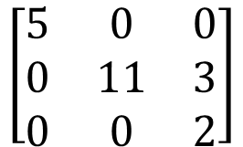
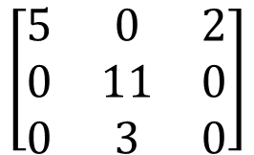
Sparse Matrix Multiplication
目的: 實作稀疏矩陣a*矩陣b
做法說明:
a
row col value
a[0] 3 3 4
[1] 0 0 5
[2] 1 1 11
[3] 1 2 3
[4] 2 2 2
[5] 3 0 0
set boundary condition
b
row col value
[0] 3 3 4
[1] 0 0 5
[2] 1 1 11
[3] 1 2 3
[4] 2 0 2
[5] 3 0 0
row col value
b[0] 3 3 4
[1] 0 0 5
[2] 0 2 2
[3] 1 1 11
[4] 2 1 3
newB
transpose
CHAPTER 2

Slide 3
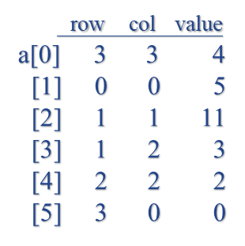
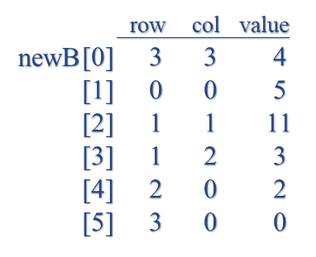
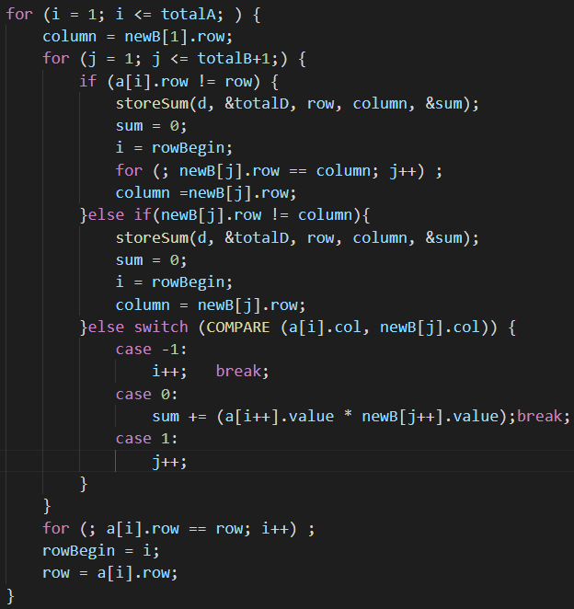
initial
rowsA=a[0].row=3 colsB=b[0].col=3
colsA=a[0].col=3
totalA=a[0].value=4 totalB=b[0].value=4
row=a[1].row=0
i = 1, j = 1, rowBegin = 1, column = 0
a[i].row=0, row=0
=> False
CHAPTER 2

Slide 4
initial
rowsA=a[0].row=3 colsB=b[0].col=3
colsA=a[0].col=3
totalA=a[0].value=4 totalB=b[0].value=4
row=a[1].row=0
i = 1, j = 1, rowBegin = 1, column = 0
newB[j].row=0, column=0
=> False
CHAPTER 2

Slide 5
initial
rowsA=a[0].row=3 colsB=b[0].col=3
colsA=a[0].col=3
totalA=a[0].value=4 totalB=b[0].value=4
row=a[1].row=0
i = 1, j = 1, rowBegin = 1, column = 0
a[1].col=0 = newB[1].col=0
=> case 0
CHAPTER 2

Slide 6
initial
rowsA=a[0].row=3 colsB=b[0].col=3
colsA=a[0].col=3
totalA=a[0].value=4 totalB=b[0].value=4
row=a[1].row=0
i = 1, j = 1, rowBegin = 1, column = 0
a[i++].value=5
newB[j++].value=5
sum=25 i=2 j=2
CHAPTER 2

Slide 7
initial
rowsA=a[0].row=3 colsB=b[0].col=3
colsA=a[0].col=3
totalA=a[0].value=4 totalB=b[0].value=4
row=a[1].row=0
i = 2, j = 2, rowBegin = 1, column = 0
a[i].row=1, row=0
=> True
CHAPTER 2

Slide 8
initial
rowsA=a[0].row=3 colsB=b[0].col=3
colsA=a[0].col=3
totalA=a[0].value=4 totalB=b[0].value=4
row=a[1].row=0
i = 2, j = 2, rowBegin = 1, column = 0
row col value
d[0] 3 3 4
[1] 0 0 25
[2]
[3]
[4]
CHAPTER 2

Slide 9
initial
rowsA=a[0].row=3 colsB=b[0].col=3
colsA=a[0].col=3
totalA=a[0].value=4 totalB=b[0].value=4
row=a[1].row=0
i = 2, j = 2, rowBegin = 1, column = 0
i=1 j=2 column=1
CHAPTER 2

Slide 10
initial
rowsA=a[0].row=3 colsB=b[0].col=3
colsA=a[0].col=3
totalA=a[0].value=4 totalB=b[0].value=4
row=a[1].row=0
i = 1, j = 2, rowBegin = 1, column = 1
a[i].row=0, row=0
=> False
CHAPTER 2

Slide 11
initial
rowsA=a[0].row=3 colsB=b[0].col=3
colsA=a[0].col=3
totalA=a[0].value=4 totalB=b[0].value=4
row=a[1].row=0
i = 1, j = 2, rowBegin = 1, column = 1
newB[j].row=1, column=1
=> False
CHAPTER 2

Slide 12
initial
rowsA=a[0].row=3 colsB=b[0].col=3
colsA=a[0].col=3
totalA=a[0].value=4 totalB=b[0].value=4
row=a[1].row=0
i = 1, j = 2, rowBegin = 1, column = 1
a[1].col=0 < newB[2].col=1
=> case -1
CHAPTER 2

Slide 13
initial
rowsA=a[0].row=3 colsB=b[0].col=3
colsA=a[0].col=3
totalA=a[0].value=4 totalB=b[0].value=4
row=a[1].row=0
i = 1, j = 2, rowBegin = 1, column = 1
i=2
CHAPTER 2

Slide 14
initial
rowsA=a[0].row=3 colsB=b[0].col=3
colsA=a[0].col=3
totalA=a[0].value=4 totalB=b[0].value=4
row=a[1].row=0
i = 2, j = 2, rowBegin = 1, column = 1
a[i].row=1, row=0
=> True
CHAPTER 2

Slide 15
initial
rowsA=a[0].row=3 colsB=b[0].col=3
colsA=a[0].col=3
totalA=a[0].value=4 totalB=b[0].value=4
row=a[1].row=0
i = 2, j = 2, rowBegin = 1, column = 1
row col value
d[0] 3 3 4
[1] 0 0 25
[2]
[3]
[4]
storeSum()判斷
沒有新的sum值需要儲存
故陣列沒有增加資料
CHAPTER 2

Slide 16
initial
rowsA=a[0].row=3 colsB=b[0].col=3
colsA=a[0].col=3
totalA=a[0].value=4 totalB=b[0].value=4
row=a[1].row=0
i = 2, j = 2, rowBegin = 1, column = 1
i=1 j=4 column=2
CHAPTER 2

Slide 17
initial
rowsA=a[0].row=3 colsB=b[0].col=3
colsA=a[0].col=3
totalA=a[0].value=4 totalB=b[0].value=4
row=a[1].row=0
i = 1, j = 4, rowBegin = 1, column = 2
a[i].row=0, row=0
=> False
CHAPTER 2

Slide 18
initial
rowsA=a[0].row=3 colsB=b[0].col=3
colsA=a[0].col=3
totalA=a[0].value=4 totalB=b[0].value=4
row=a[1].row=0
i = 1, j = 4, rowBegin = 1, column = 2
newB[j].row=2, column=2
=> False
CHAPTER 2

Slide 19
initial
rowsA=a[0].row=3 colsB=b[0].col=3
colsA=a[0].col=3
totalA=a[0].value=4 totalB=b[0].value=4
row=a[1].row=0
i = 1, j = 4, rowBegin = 1, column = 2
a[1].col=0 = newB[4].col=0
=> case 0
CHAPTER 2

Slide 20
initial
rowsA=a[0].row=3 colsB=b[0].col=3
colsA=a[0].col=3
totalA=a[0].value=4 totalB=b[0].value=4
row=a[1].row=0
i = 1, j = 4, rowBegin = 1, column = 2
a[i++].value=5
newB[j++].value=2
sum=10 i=2 j=5
CHAPTER 2

Slide 21
initial
rowsA=a[0].row=3 colsB=b[0].col=3
colsA=a[0].col=3
totalA=a[0].value=4 totalB=b[0].value=4
row=a[1].row=0
i = 2, j = 5, rowBegin = 1, column = 2
a[i].row=1, row=0
=> True
CHAPTER 2

Slide 22
initial
rowsA=a[0].row=3 colsB=b[0].col=3
colsA=a[0].col=3
totalA=a[0].value=4 totalB=b[0].value=4
row=a[1].row=0
i = 2, j = 5, rowBegin = 1, column = 2
row col value
d[0] 3 3 4
[1] 0 0 25
[2] 0 2 10
[3]
[4]
CHAPTER 2

Slide 23
initial
rowsA=a[0].row=3 colsB=b[0].col=3
colsA=a[0].col=3
totalA=a[0].value=4 totalB=b[0].value=4
row=a[1].row=0
i = 2, j = 5, rowBegin = 1, column = 2
i=1 j=5 column=3
CHAPTER 2

Slide 24
initial
rowsA=a[0].row=3 colsB=b[0].col=3
colsA=a[0].col=3
totalA=a[0].value=4 totalB=b[0].value=4
row=a[1].row=0
i = 1, j = 5, rowBegin = 1, column = 3
a[i].row=0, row=0
=> False
CHAPTER 2

Slide 25
initial
rowsA=a[0].row=3 colsB=b[0].col=3
colsA=a[0].col=3
totalA=a[0].value=4 totalB=b[0].value=4
row=a[1].row=0
i = 1, j = 5, rowBegin = 1, column = 3
newB[j].row=3, column=3
=> False
CHAPTER 2

Slide 26
initial
rowsA=a[0].row=3 colsB=b[0].col=3
colsA=a[0].col=3
totalA=a[0].value=4 totalB=b[0].value=4
row=a[1].row=0
i = 1, j = 5, rowBegin = 1, column = 3
a[1].col=0 = newB[5].col=0
=> case 0
CHAPTER 2

Slide 27
initial
rowsA=a[0].row=3 colsB=b[0].col=3
colsA=a[0].col=3
totalA=a[0].value=4 totalB=b[0].value=4
row=a[1].row=0
i = 1, j = 5, rowBegin = 1, column = 3
a[i++].value=5
newB[j++].value=0
sum=0 i=2 j=6
CHAPTER 2

Slide 28
initial
rowsA=a[0].row=3 colsB=b[0].col=3
colsA=a[0].col=3
totalA=a[0].value=4 totalB=b[0].value=4
row=a[1].row=0
i = 2, j = 6, rowBegin = 1, column = 3
column = 0
CHAPTER 2
i=2 rowBegin=2 row=1

Slide 29
Round 2
rowsA=a[0].row=3 colsB=b[0].col=3
colsA=a[0].col=3
totalA=a[0].value=4 totalB=b[0].value=4
row=a[2].row=1
i = 2, j = 1, rowBegin = 2, column = 0
a[i].row=1, row=1
=> False
CHAPTER 2

Slide 30
Round 2
rowsA=a[0].row=3 colsB=b[0].col=3
colsA=a[0].col=3
totalA=a[0].value=4 totalB=b[0].value=4
row=a[2].row=1
i = 2, j = 1, rowBegin = 2, column = 0
newB[j].row=0, column=0
=> False
CHAPTER 2

Slide 31
Round 2
rowsA=a[0].row=3 colsB=b[0].col=3
colsA=a[0].col=3
totalA=a[0].value=4 totalB=b[0].value=4
row=a[2].row=1
i = 2, j = 1, rowBegin = 2, column = 0
a[2].col=1 > newB[1].col=0
=> case 1
CHAPTER 2

Slide 32
Round 2
rowsA=a[0].row=3 colsB=b[0].col=3
colsA=a[0].col=3
totalA=a[0].value=4 totalB=b[0].value=4
row=a[2].row=1
i = 2, j = 1, rowBegin = 2, column = 0
j=2
CHAPTER 2

Slide 33
Round 2
rowsA=a[0].row=3 colsB=b[0].col=3
colsA=a[0].col=3
totalA=a[0].value=4 totalB=b[0].value=4
row=a[2].row=1
i = 2, j = 2, rowBegin = 2, column = 0
a[i].row=1, row=1
=> False
CHAPTER 2

Slide 34
Round 2
rowsA=a[0].row=3 colsB=b[0].col=3
colsA=a[0].col=3
totalA=a[0].value=4 totalB=b[0].value=4
row=a[2].row=1
i = 2, j = 2, rowBegin = 2, column = 0
newB[j].row=1, column=0
=> True
CHAPTER 2

Slide 35
Round 2
rowsA=a[0].row=3 colsB=b[0].col=3
colsA=a[0].col=3
totalA=a[0].value=4 totalB=b[0].value=4
row=a[2].row=1
i = 2, j = 2, rowBegin = 2, column = 0
row col value
d[0] 3 3 4
[1] 0 0 25
[2] 0 2 10
[3]
[4]
storeSum()判斷
沒有新的sum值需要儲存
故陣列沒有增加資料
CHAPTER 2

Slide 36
Round 2
rowsA=a[0].row=3 colsB=b[0].col=3
colsA=a[0].col=3
totalA=a[0].value=4 totalB=b[0].value=4
row=a[2].row=1
i = 2, j = 2, rowBegin = 2, column = 0
i=2 column=1
CHAPTER 2

Slide 37
Round 2
rowsA=a[0].row=3 colsB=b[0].col=3
colsA=a[0].col=3
totalA=a[0].value=4 totalB=b[0].value=4
row=a[2].row=1
i = 2, j = 2, rowBegin = 2, column = 1
a[i].row=1, row=1
=> False
CHAPTER 2

Slide 38
Round 2
rowsA=a[0].row=3 colsB=b[0].col=3
colsA=a[0].col=3
totalA=a[0].value=4 totalB=b[0].value=4
row=a[2].row=1
i = 2, j = 2, rowBegin = 2, column = 1
newB[j].row=1, column=1
=> False
CHAPTER 2

Slide 39
Round 2
rowsA=a[0].row=3 colsB=b[0].col=3
colsA=a[0].col=3
totalA=a[0].value=4 totalB=b[0].value=4
row=a[2].row=1
i = 2, j = 2, rowBegin = 2, column = 1
a[2].col=1 = newB[2].col=1
=> case 0
CHAPTER 2

Slide 40
Round 2
rowsA=a[0].row=3 colsB=b[0].col=3
colsA=a[0].col=3
totalA=a[0].value=4 totalB=b[0].value=4
row=a[2].row=1
i = 2, j = 2, rowBegin = 2, column = 1
a[i++].value=11
newB[j++].value=11
sum=121 i=3 j=3
CHAPTER 2

Slide 41
Round 2
rowsA=a[0].row=3 colsB=b[0].col=3
colsA=a[0].col=3
totalA=a[0].value=4 totalB=b[0].value=4
row=a[2].row=1
i = 3, j = 3, rowBegin = 2, column = 1
a[i].row=1, row=1
=> False
CHAPTER 2

Slide 42
Round 2
rowsA=a[0].row=3 colsB=b[0].col=3
colsA=a[0].col=3
totalA=a[0].value=4 totalB=b[0].value=4
row=a[2].row=1
i = 3, j = 3, rowBegin = 2, column = 1
newB[j].row=1, column=1
=> False
CHAPTER 2

Slide 43
Round 2
rowsA=a[0].row=3 colsB=b[0].col=3
colsA=a[0].col=3
totalA=a[0].value=4 totalB=b[0].value=4
row=a[2].row=1
i = 3, j = 3, rowBegin = 2, column = 1
a[3].col=2 = newB[3].col=2
=> case 0
CHAPTER 2

Slide 44
Round 2
rowsA=a[0].row=3 colsB=b[0].col=3
colsA=a[0].col=3
totalA=a[0].value=4 totalB=b[0].value=4
row=a[2].row=1
i = 3, j = 3, rowBegin = 2, column = 1
a[i++].value=3
newB[j++].value=3
sum=11*11+3*3=130 i=4 j=4
CHAPTER 2

Slide 45
Round 2
rowsA=a[0].row=3 colsB=b[0].col=3
colsA=a[0].col=3
totalA=a[0].value=4 totalB=b[0].value=4
row=a[2].row=1
i = 4, j = 4, rowBegin = 2, column = 1
a[i].row=2, row=1
=> True
CHAPTER 2

Slide 46
Round 2
rowsA=a[0].row=3 colsB=b[0].col=3
colsA=a[0].col=3
totalA=a[0].value=4 totalB=b[0].value=4
row=a[2].row=1
i = 4, j = 4, rowBegin = 2, column = 1
row col value
d[0] 3 3 4
[1] 0 0 25
[2] 0 2 10
[3] 1 1 130
[4]
CHAPTER 2

Slide 47
Round 2
rowsA=a[0].row=3 colsB=b[0].col=3
colsA=a[0].col=3
totalA=a[0].value=4 totalB=b[0].value=4
row=a[2].row=1
i = 4, j = 4, rowBegin = 2, column = 1
i=2 j=4 column=2
CHAPTER 2

Slide 48
Round 2
rowsA=a[0].row=3 colsB=b[0].col=3
colsA=a[0].col=3
totalA=a[0].value=4 totalB=b[0].value=4
row=a[2].row=1
i = 2, j = 4, rowBegin = 2, column = 2
以此類推
row col value
d[0] 3 3 4
[1] 0 0 25
[2] 0 2 10
[3] 1 1 130
[4] 2 1 6
CHAPTER 2

